Slide 1


Front End Development
Presentated by Jay Khatara

Slide 2







What Is Front-end ?
Front-end development is the development of the graphical user interface of a website.
Common Languages
Advance Languages

Slide 3

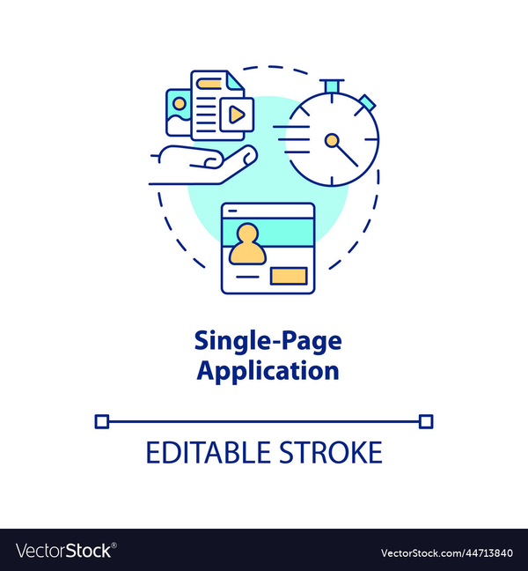




Current tech
Single Page Applications
No Code/Low Code
Server-Side Rendering
Autocoding Platforms
Chatbots and AI

Slide 4
React Js vs Angular Js
Faster
Easy to use
One page applicaton
Based on reusable com.
Library of JS

Slide 5
Thank you

